Slide 1

2022-2 APPLICATIONS AND PRACTICE IN NEURAL NETWORKS
Natural Language Processing with Disaster Tweets
2021010192
Kim Jae Kyoung
Notes:
안녕하세요 신경망 응용수업 첫번째 프로젝트로 code similarity estimation을 골랐습니다.
Hello, I chose the project which name is Natural Language Processing with Disaster Tweets
as the second project of the APPLICATIONS AND PRACTICE IN NEURAL NETWORKS

Slide 2


01
02
03
04
CONTENTS
Project description
Basic Model
New model
Results
Notes:
I will proceed with the order of project description basic model New model conclusion.

Slide 3
01 Project description
Goal & Necessity & Dataset
Goal
You are predicting whether a given tweet is about a real disaster or not.
Necessity
The ubiquitousness of smartphones enables people to announce an emergency they’re observing in real-time.
Because of this, more agencies are interested in programatically monitoring Twitter
But, it’s not always clear whether a person’s words are actually announcing a disaster.
Dataset
train.csv - the training set
test.csv - the test set
sample_submission.csv - a sample submission file in the correct format
Notes:
해당 프로젝트의 목표는 두개의 코드가 유사한 코드인지 아닌지를 예측하는 과제입니다.
The goal of the project is to predict whether a given tweet is about a real disaster or not.
해당 프로젝트가 필요한 이유는 다음과 같습니다.
The following reasons are required for this project:
The ubiquitousness of smartphones enables people to announce an emergency they’re observing in real-time.
Because of this, more agencies are interested in programatically monitoring Twitter
But, it’s not always clear whether a person’s words are actually announcing a disaster.
다음은 해당 프로젝트에 사용되는 데이터를 알아보겠습니다.
Next, let's look at the data used for the project.
There are 3 dataset in this task

Slide 4
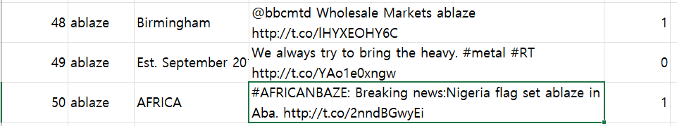
01 Project description
Dataset
Columns
id : a unique identifier for each tweet
text : the text of the tweet
location : the location the tweet was sent from (may be blank)
keyword : a particular keyword from the tweet (may be blank)
target : in train.csv only, this denotes whether a tweet is about a real disaster (1) or not (0)
Sample
id
keyword
Location
text
target
Notes:
There are a few columns.
id is a unique identifier for each tweet
text is the text of the tweet
location is the location the tweet was sent from (may be blank)
keyword is a particular keyword from the tweet (may be blank)
target is in train.csv only, this denotes whether a tweet is about a real disaster (1) or not (0)
Here is the sample of train.csv
In the text columns, we can see the url and some expression usually used in tweet such as @, # (hash tag)
In the target columns 1 means this tweet is disaster tweet, 0 means tweet Is not disaster tweet.

Slide 5
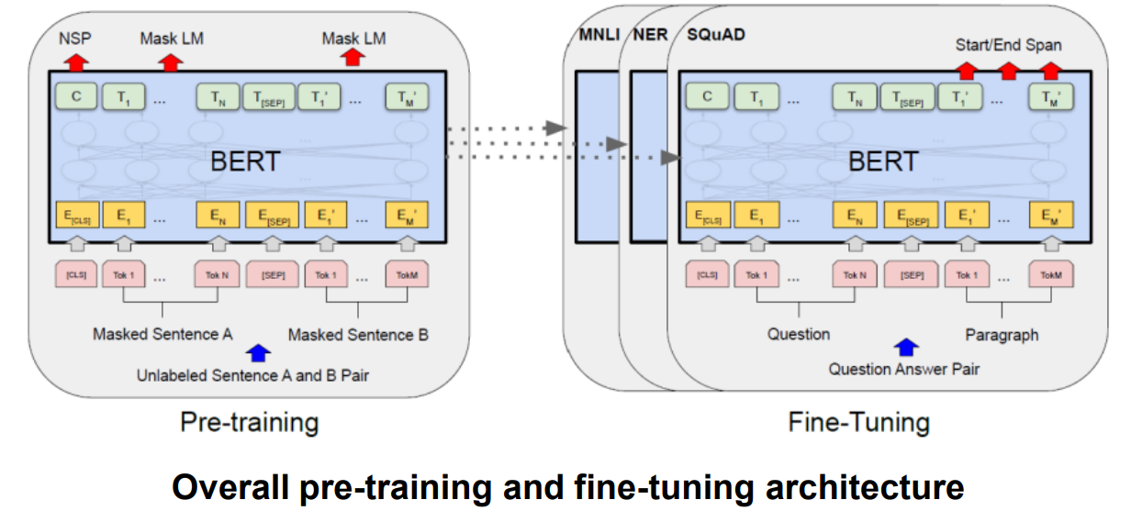
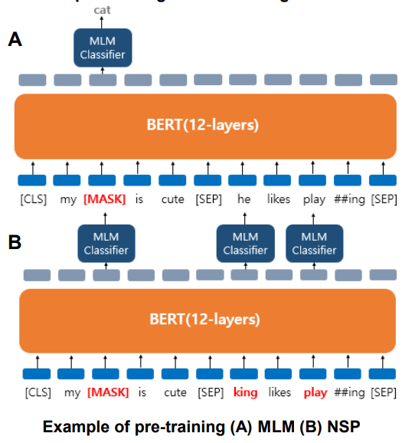
02 Basic model
BERT
Pre-training
Using massive data without labels
Masked language model (MLM) » Text random masking
Next sentence prediction (NSP) » Train with randomly concatenated sentences
Fine-tuning
Using additional tasks with labels – Single text classification
ex) emotion classification – Tagging – Question answering
Notes:
Basic model is BERT
BERT is encoder of Transformer
And as you knwo, Transformer encoder has 12 or 24 layers
Bert uses Word embedding with context.
In Pre-training of BERT , It Uses massive data without labels.
First, It uses Masked language model (MLM) and Next sentence prediction (NSP)
In Fine-tuning of BERT, It uses additional tasks with labels

Slide 6
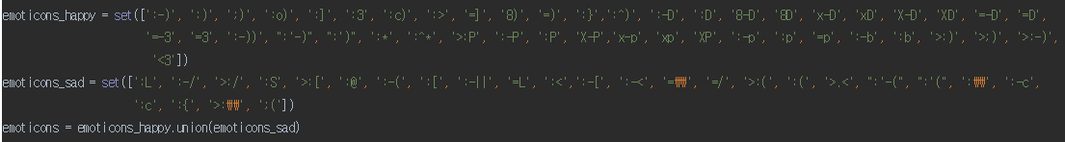
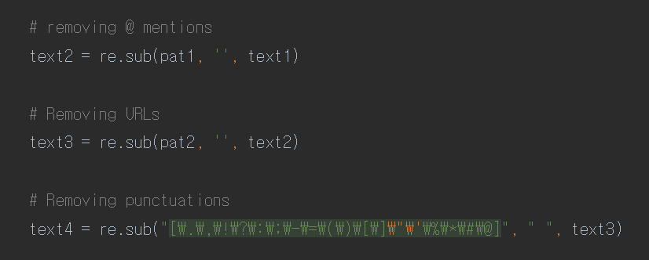
03 New model
Remove
1) Remove emoticon
2) Remove @ mentions, URLs , punctuations,
Notes:
Our model treats text with removing emoticon that are usually used in website,
And removing @ mentions, urls, punctuations.
These are the preprocessing methods that are generally performed a lot.
However, the @ part is a special expression mainly used on Twitter that tags the other person. For example @jaekyoungkim @id

Slide 7
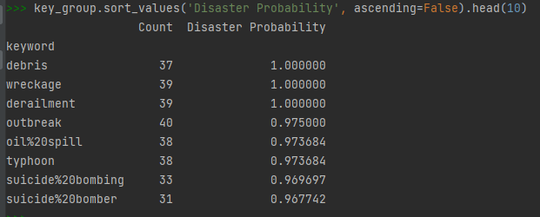
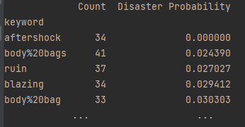
03 New model
Keyword
Calculating disaster probability within keyword
High disaster prob keyword
Low disaster prob keyword
Notes:
Some keyword is critically important in the prediction.
Debris keyword appears 37 times and 100% of the this keyword is disaster tweet.
Wrekage and derailment are also 100% of the disaster tweet
Whearas, aftershock keyword appears 34 times, but 0% of the this keyword is disaster tweet
After next section, we will use this idea in the model.

Slide 8
03 New model
Change word
Change abbreviations
"asap" : "as soon as possible"
"b2b" : "business to business"
"btw" : "by the way"
"g9" : "genius"
"goat" : "greatest of all time"
"ic" : "i see"
"j4f" : "just for fun"
"l8r" : "later“
…
Notes:
Twitter abbreviations and acronyms are an odd mash-up of text slang, old school chat room phrases, common sense short forms and corporate buzzwords.
There is nothing more terrible than parsing a customer tweet and finding out what you once thought was a compliment was really a product slam or worse, a drug reference.
There are some example of abbreviations
Asap means as soon as possible
B2b means business to business
Btw by thew way

Slide 9
03 New model
Models
[1] Only text
Batch size : 32
Max length : 60 / 70
[2] Concat(keyword, text)
Batch size : 32
Max length : 60 / 70
New text : Concat(keyword , text)
[3] Using proportion keyword
Batch size : 32
Max length : 60
If keyword disaster prob > threshold (Disaster_Probability) : hardcoding 1
If keyword not disaster prob < threshold (not_Disaster_Probability) : hardcoding 0
Notes:
[1] Only text model uses only text , batch size is 32 and max length is set to 60 and 70
[2] Second model is concatenation of keyword and text. Length of keyword usually 2 to 4 words.
Batch size is also 32 and max length is set to 60 or 70
[3] last model is using proportion keyword
Some keyword debirs, Debris keyword appears 37 times and 100% of the this keyword is disaster tweet.
If keyword disaster prob > threshold (Disaster_Probability) : hardcoding 1
If keyword not disaster prob < threshold (not_Disaster_Probability) : hardcoding 0
In this model batch size is 32, and max length is 60.

Slide 10
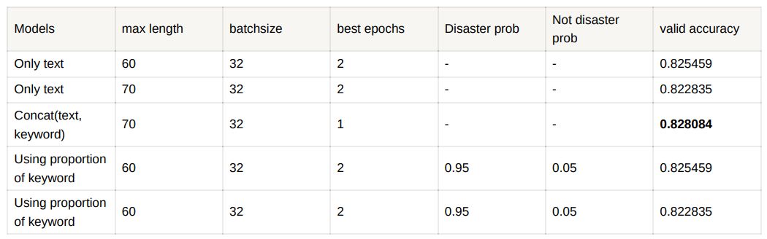
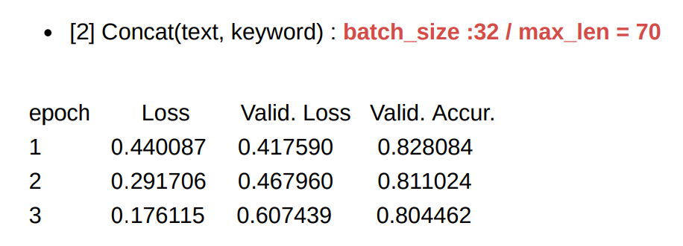
03 New model
Result
Notes:
61 for maximum sentence length and 60 for today - - Padding more than max length seems to degrade performance
Here is the results
Concatenation of text and keyword shows best valid accuracy.
In this model, max length is 70 and best epochs at epoch 1.
Detail of model loss and valid loss, valid accurary is below.

Slide 11
04 Conclusion
Conclusion
Performance comparison
Before
After
▪Basic model : LSTM
Best at epochs : 5
➢ Validation accuracy: 56.1%
▪Our model : BERT
Best at epochs : 1
➢ Validation accuracy: 82.81%
Validation accuracy 26.71% up
Notes:
Here is the conclusion.
I added new method (BERT with preprocessing)
In the previous basic model, valid accuracy is 56.1% in 5 epoch
In our model, valid accuracy is 82.81% in 1 epochs
26.71% up in the valid accuracy.
Social media has been drawing attentions from researchers and practitioners in the field of disaster management. Accurate message classification is a necessary requirement to make decisions from the abundant but noisy user-generated data such as tweeter.
BERT-based classifiers could attain better performance compared with the LSTM baseline model.

Slide 12

Thank you
Notes:
thanks

